Slide 1
Journey PPT IDA Custom Training week-3
By Soumya Sourav Behera
Batch-01

Slide 2
Day-01: Azure Synapse Analytics
Introduction
Provisioning SQL Data warehouse
Azure synapse mapping dataflow
Azure synapse pipeline
Ingest data from various sources into SQL DW
Querying and analyzing data
Understand Query performance and optimization techniques

Slide 3
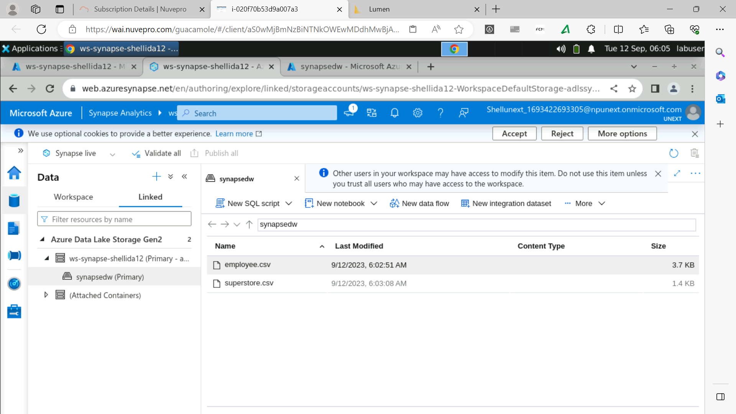

Slide 4
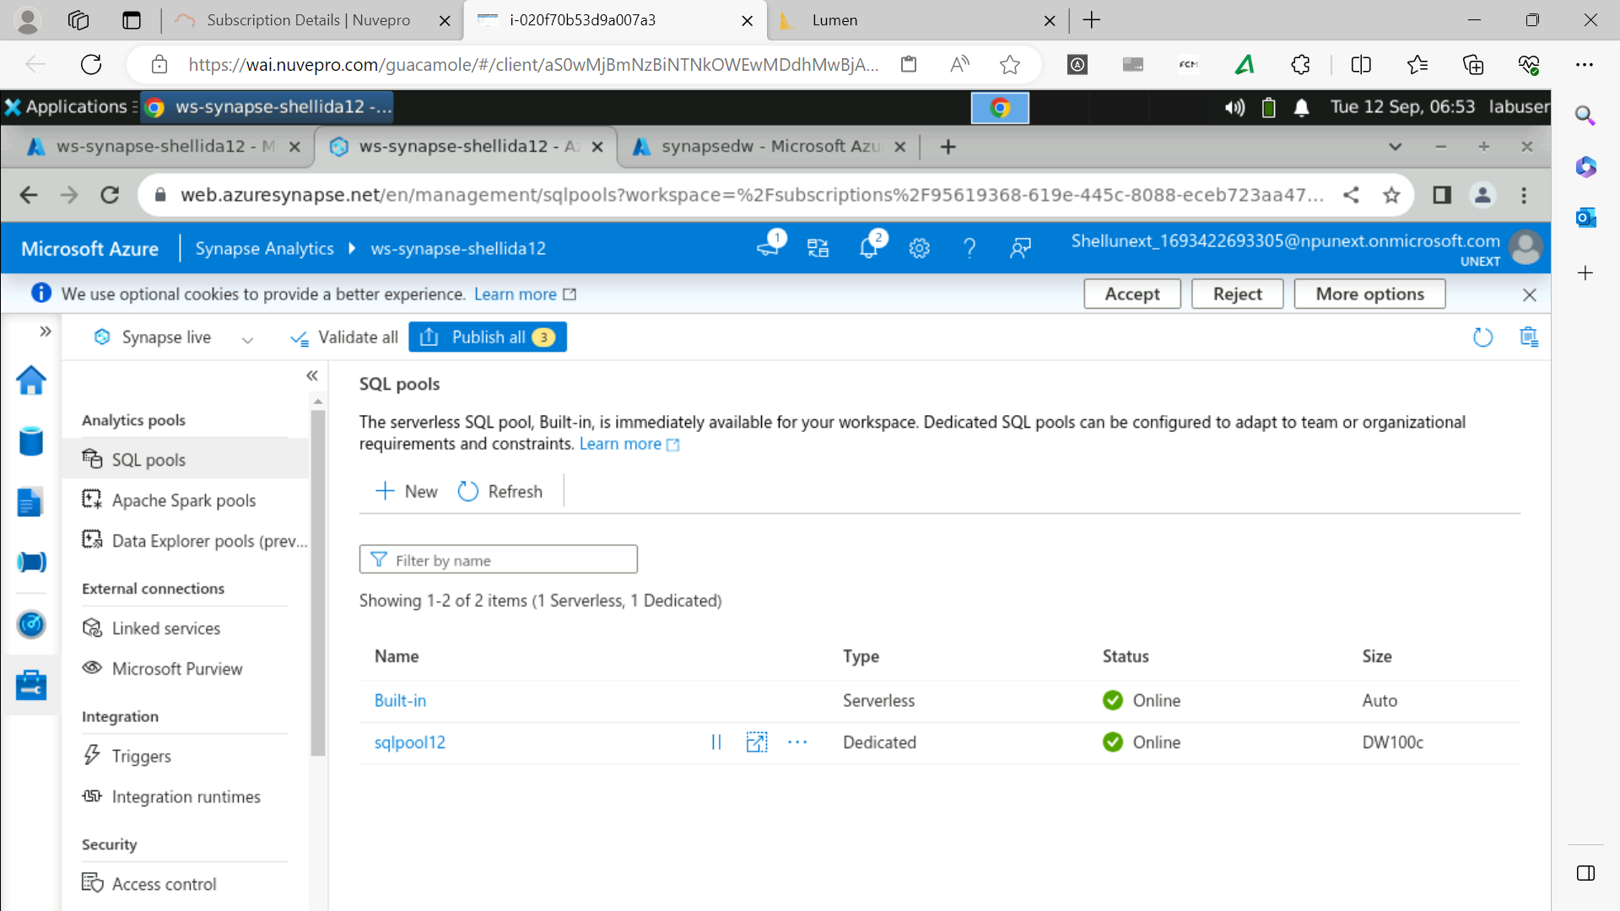

Slide 5
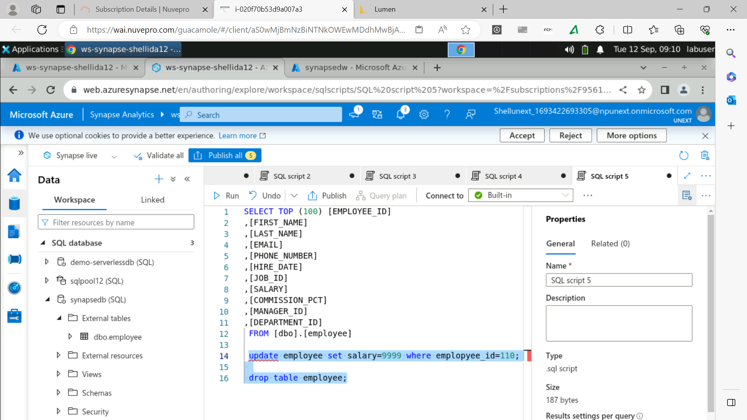

Slide 6
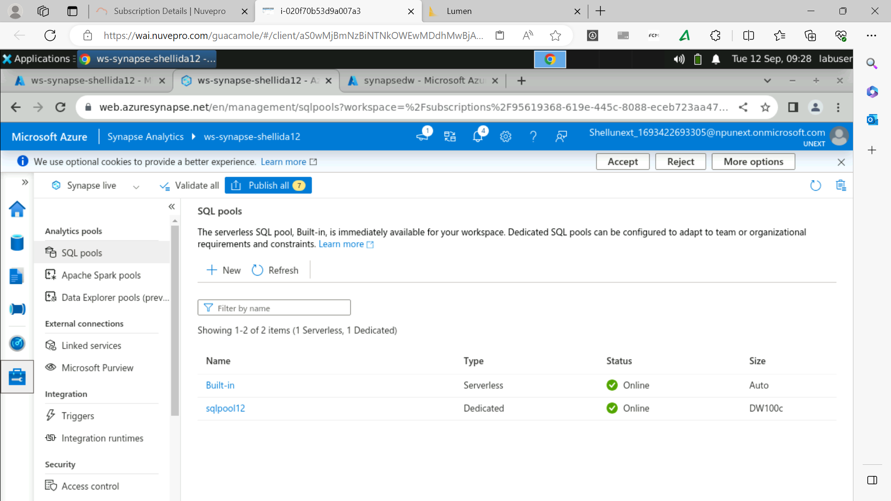

Slide 7
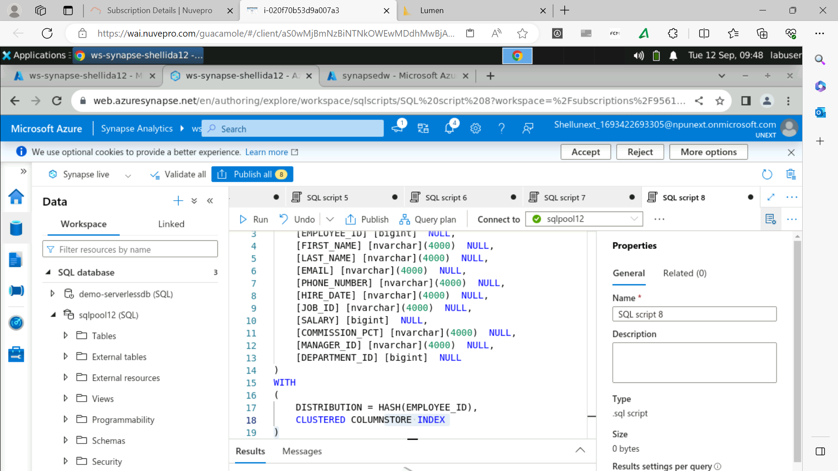

Slide 8
Day-02 : Data Visualization using Power BI -1
Introduction
Connecting to various sources
Data Loading and Transformation
DAX and Calculated columns
Aggregation functions

Slide 9
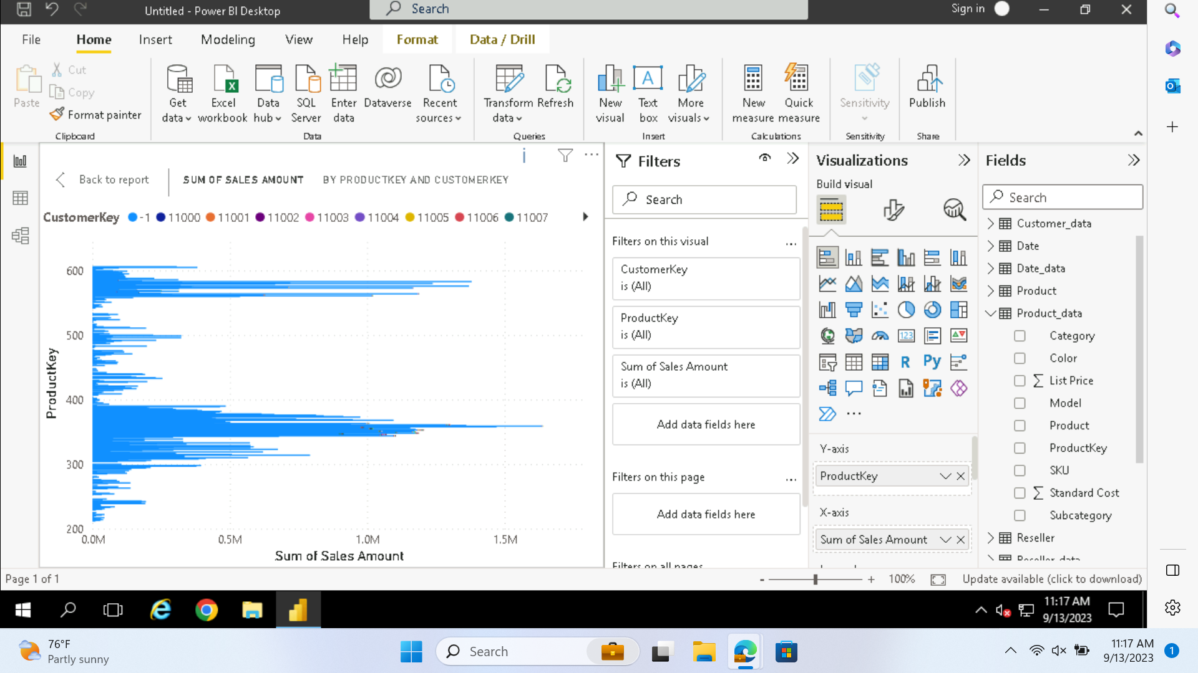

Slide 10
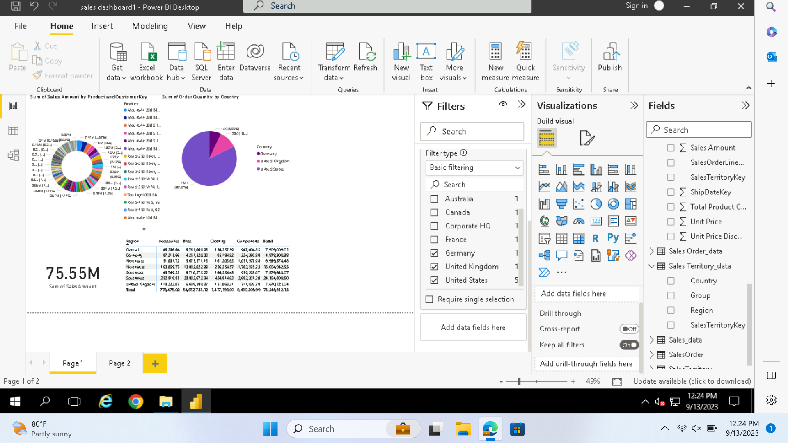

Slide 11
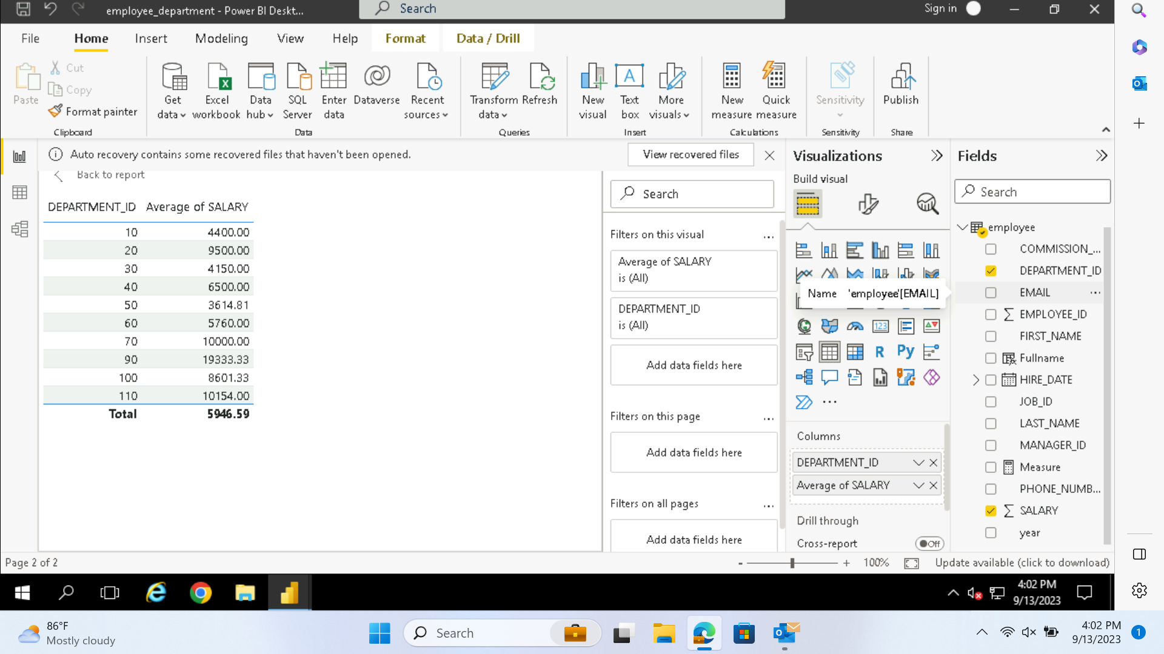

Slide 12
Day-03: Data Visualization using Power BI: 2
Understanding various charts
Univariate and Bivariate analysis
Reports and Dashboards
Managing Roles

Slide 13
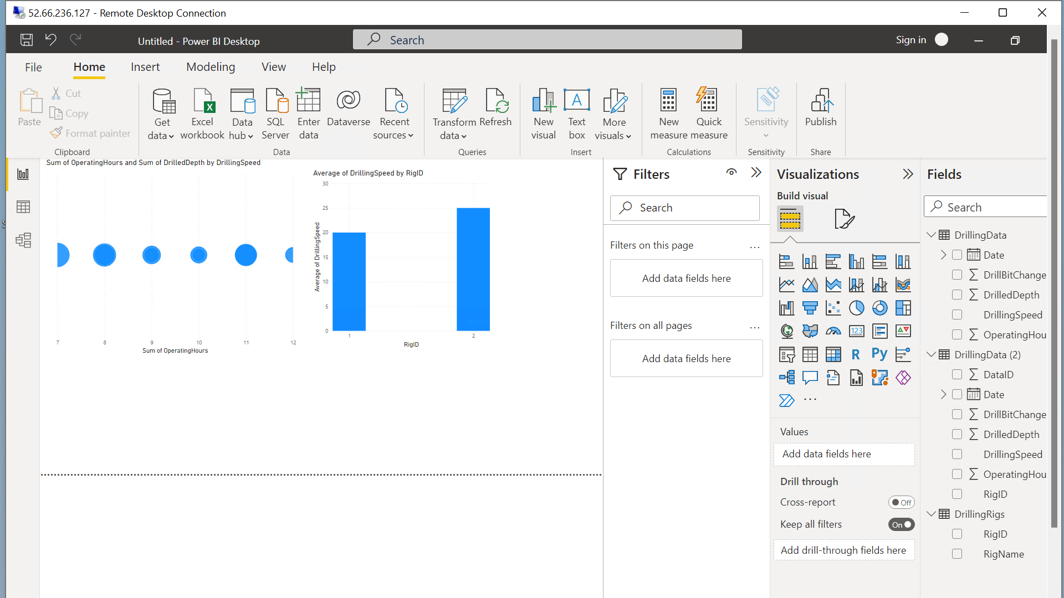

Slide 14
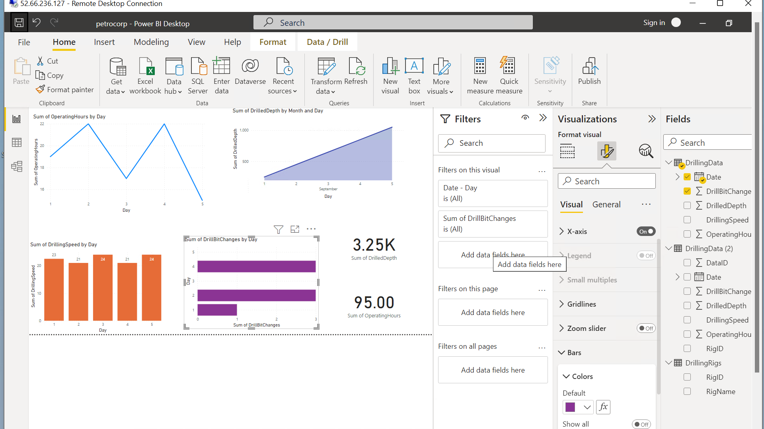

Slide 15
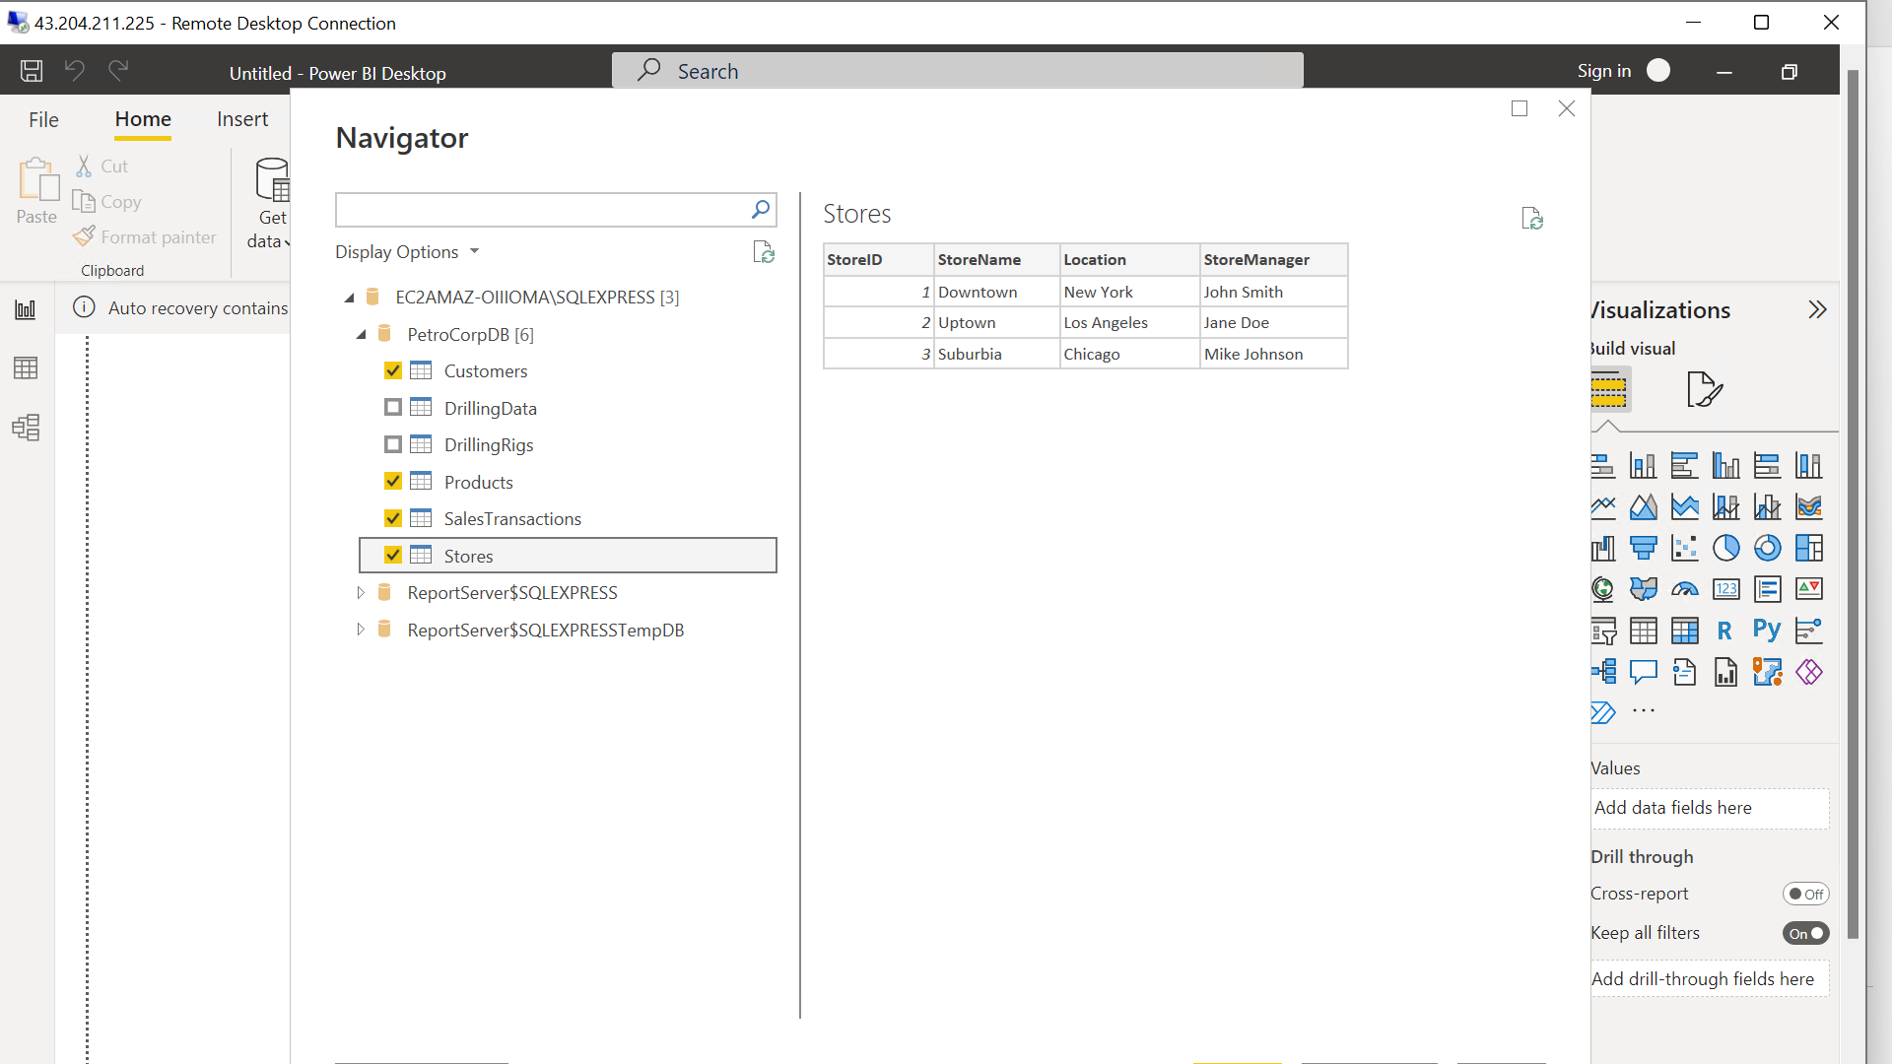

Slide 16
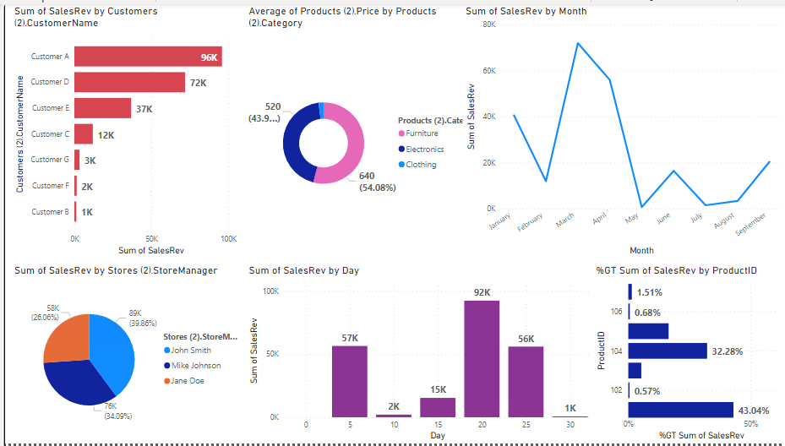

Slide 17
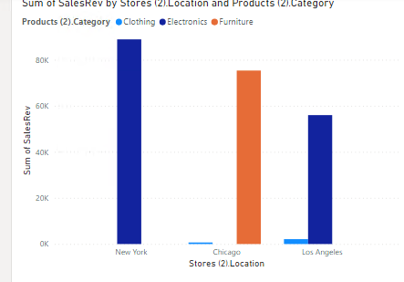

Slide 18
Day-04: Python-1
Introduction
Integer, floats and strings
Boolean values
Arithmetic operators
Logical operators
String Formatting
List, tuples, Dictionary
String Formatting
Zip function

Slide 19
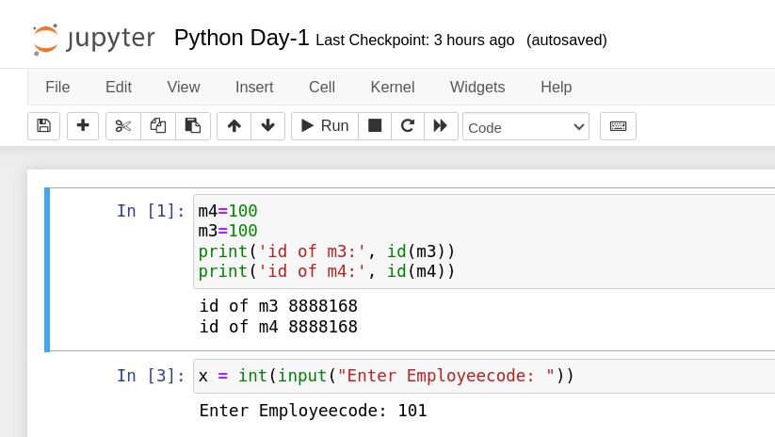

Slide 20
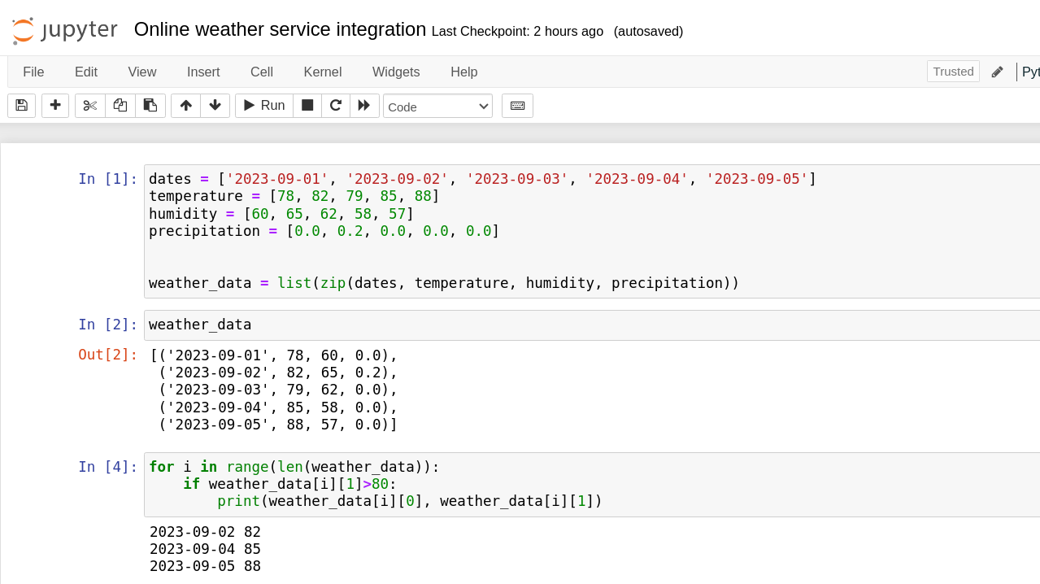

Slide 21
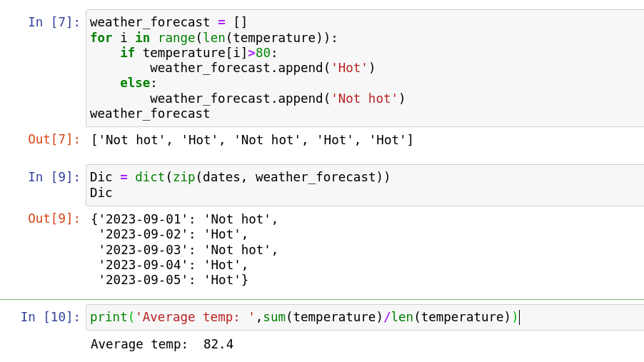

Slide 22
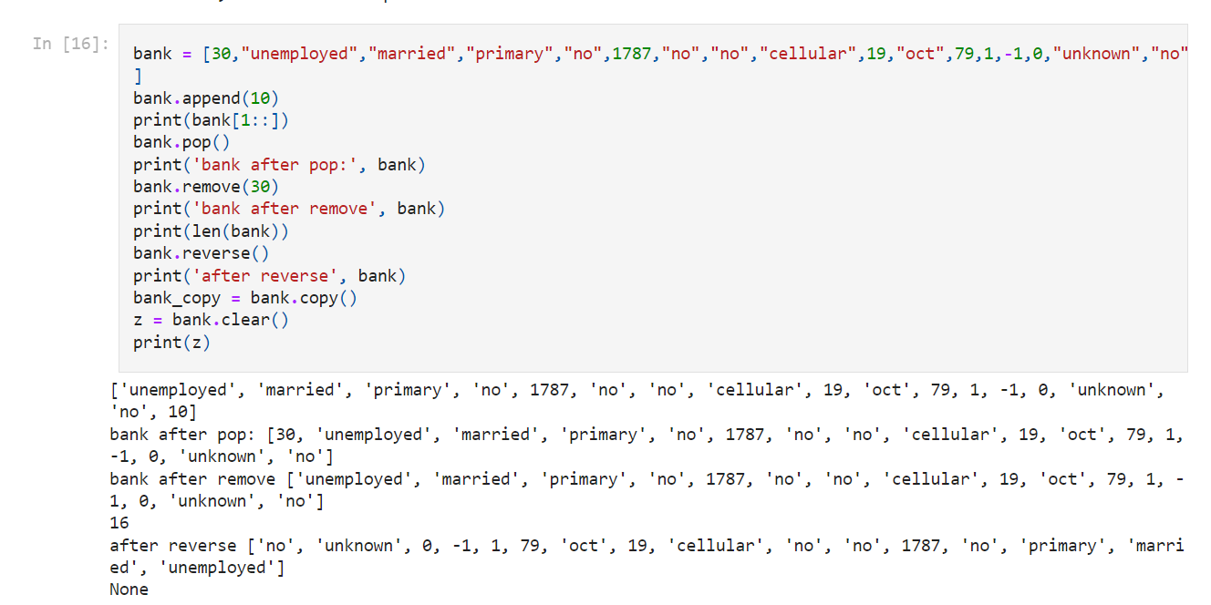

Slide 23
